Slide 1
Introduction to Hadoop

Slide 2
Hadoop and its Ecosystem
Introduction: Hadoop Ecosystem is a platform or a suite which provides various services to solve the big data problems. It includes Apache projects and various commercial tools and solutions. There are four major elements of Hadoop i.e. HDFS, MapReduce, YARN, and Hadoop Common. Most of the tools or solutions are used to supplement or support these major elements. All these tools work collectively to provide services such as absorption, analysis, storage and maintenance of data etc.

Slide 3
Following are the components that collectively form a Hadoop ecosystem:
HDFS: Hadoop Distributed File System
YARN: Yet Another Resource Negotiator
MapReduce: Programming based Data Processing
Spark: In-Memory data processing
PIG, HIVE: Query based processing of data services
HBase: NoSQL Database
Mahout, Spark MLLib: Machine Learning algorithm libraries
Solar, Lucene: Searching and Indexing
Zookeeper: Managing cluster
Oozie: Job Scheduling

Slide 4
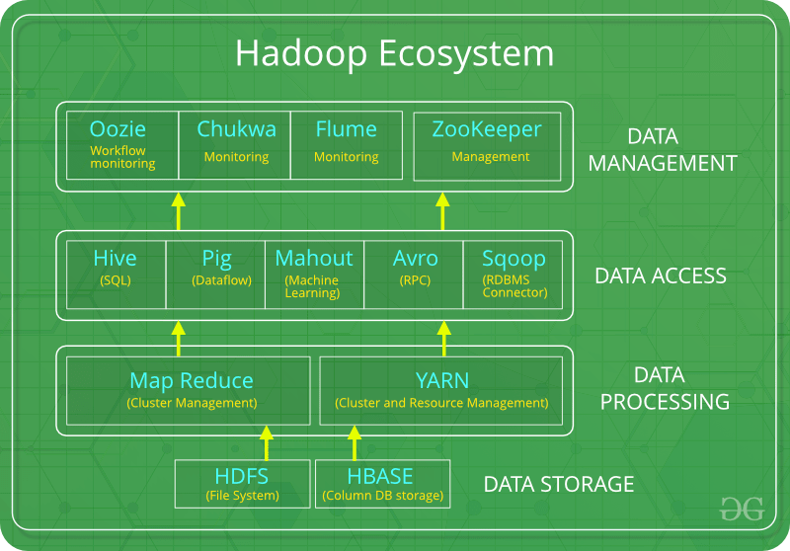

Slide 5
Hadoop HDFS
Data is stored in a distributed manner in HDFS. There are two components of HDFS - name node and data node. While there is only one name node, there can be multiple data nodes.
HDFS is specially designed for storing huge datasets in commodity hardware. An enterprise version of a server costs roughly $10,000 per terabyte for the full processor. In case you need to buy 100 of these enterprise version servers, it will go up to a million dollars.
Hadoop enables you to use commodity machines as your data nodes. This way, you don’t have to spend millions of dollars just on your data nodes. However, the name node is always an enterprise server.
Features of HDFS
Provides distributed storage
Can be implemented on commodity hardware
Provides data security
Highly fault-tolerant - If one machine goes down, the data from that machine goes to the next machine

Slide 6
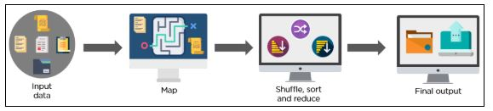
Hadoop MapReduce
Hadoop MapReduce is the processing unit of Hadoop. In the MapReduce approach, the processing is done at the slave nodes, and the final result is sent to the master node.
A data containing code is used to process the entire data. This coded data is usually very small in comparison to the data itself. You only need to send a few kilobytes worth of code to perform a heavy-duty process on computers.

Slide 7
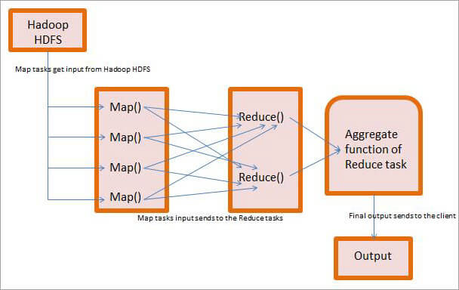

Slide 8
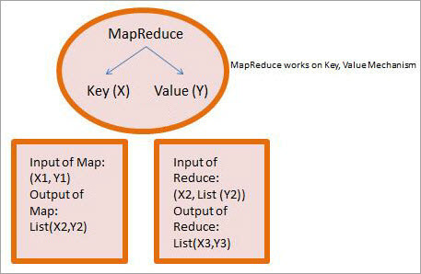

Slide 9
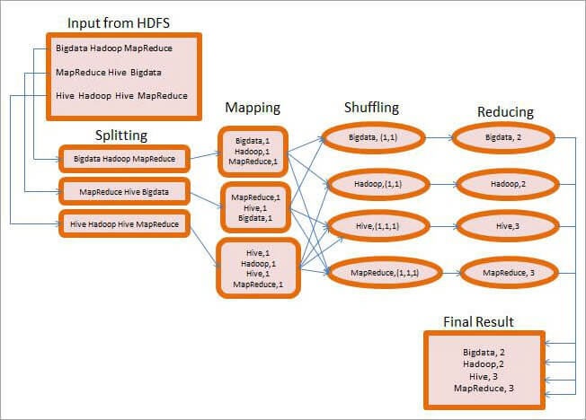

Slide 10
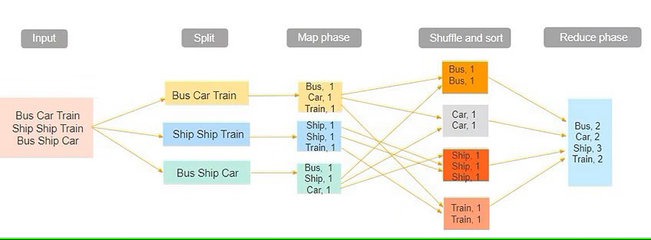
`

Slide 11
The input dataset is first split into chunks of data. In this example, the input has three lines of text with three separate entities - “bus car train,” “ship ship train,” “bus ship car.” The dataset is then split into three chunks, based on these entities, and processed parallelly.
In the map phase, the data is assigned a key and a value of 1. In this case, we have one bus, one car, one ship, and one train.
These key-value pairs are then shuffled and sorted together based on their keys. At the reduce phase, the aggregation takes place, and the final output is obtained.

Slide 12
Advantages of MapReduce
1. Parallel Processing
In MapReduce, we are dividing the job among multiple nodes and each node works with a part of the job simultaneously.
So, MapReduce is based on Divide and Conquer paradigm which helps us to process the data using different machines.
As the data is processed by multiple machines instead of a single machine in parallel, the time taken to process the data gets reduced by a tremendous amount

Slide 13
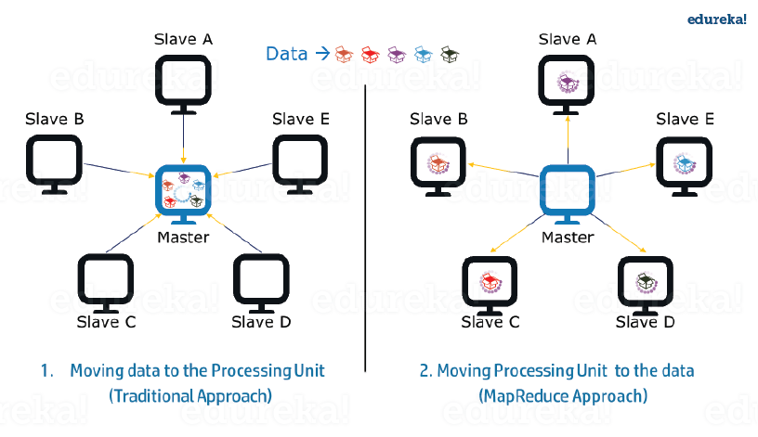
Data locality

Slide 14
Issues
Moving huge data to processing is costly and deteriorates the network performance.
Processing takes time as the data is processed by a single unit which becomes the bottleneck.
The master node can get over-burdened and may fail.

Slide 15
Solution
Now, MapReduce allows us to overcome the above issues by bringing the processing unit to the data. So, as you can see in the above image that the data is distributed among multiple nodes where each node processes the part of the data residing on it.

Slide 16
Hadoop YARN
Hadoop YARN stands for Yet Another Resource Negotiator. It is the resource management unit of Hadoop and is available as a component of Hadoop version 2.
Hadoop YARN acts like an OS to Hadoop. It is a file system that is built on top of HDFS.
It is responsible for managing cluster resources to make sure you don't overload one machine.
It performs job scheduling to make sure that the jobs are scheduled in the right place

Slide 17
Apache Hadoop YARN Architecture consists of the following main components :
Resource Manager: Runs on a master daemon and manages the resource allocation in the cluster.
Node Manager: They run on the slave daemons and are responsible for the execution of a task on every single Data Node.
Application Master: Manages the user job lifecycle and resource needs of individual applications. It works along with the Node Manager and monitors the execution of tasks.
Container: Package of resources including RAM, CPU, Network, HDD etc on a single node.

Slide 18
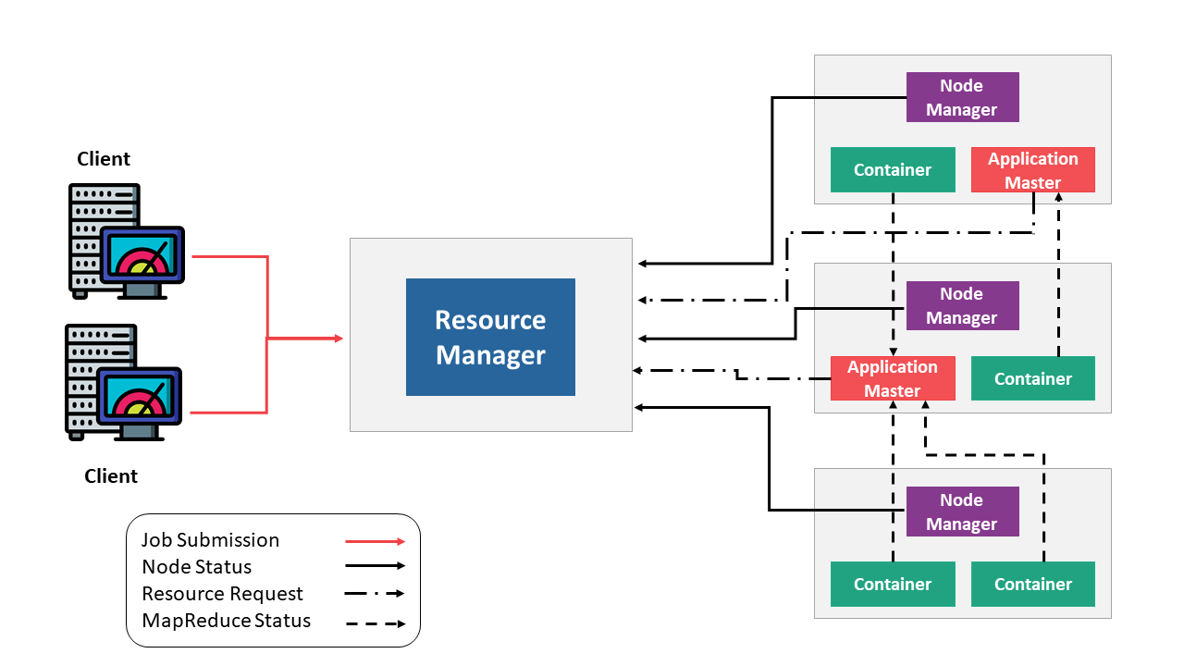

Slide 19
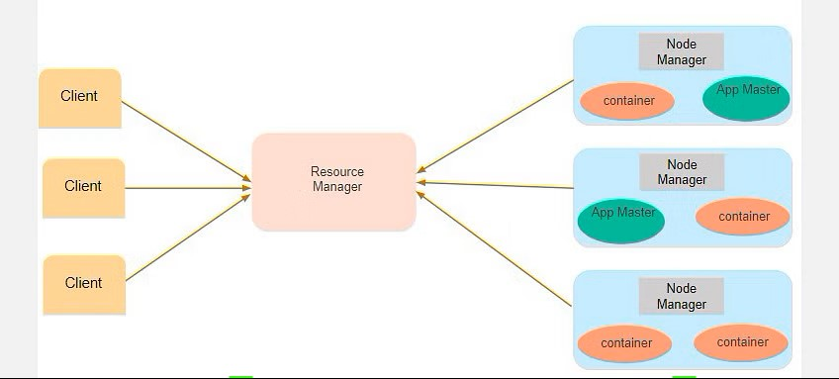
CON…

Slide 20
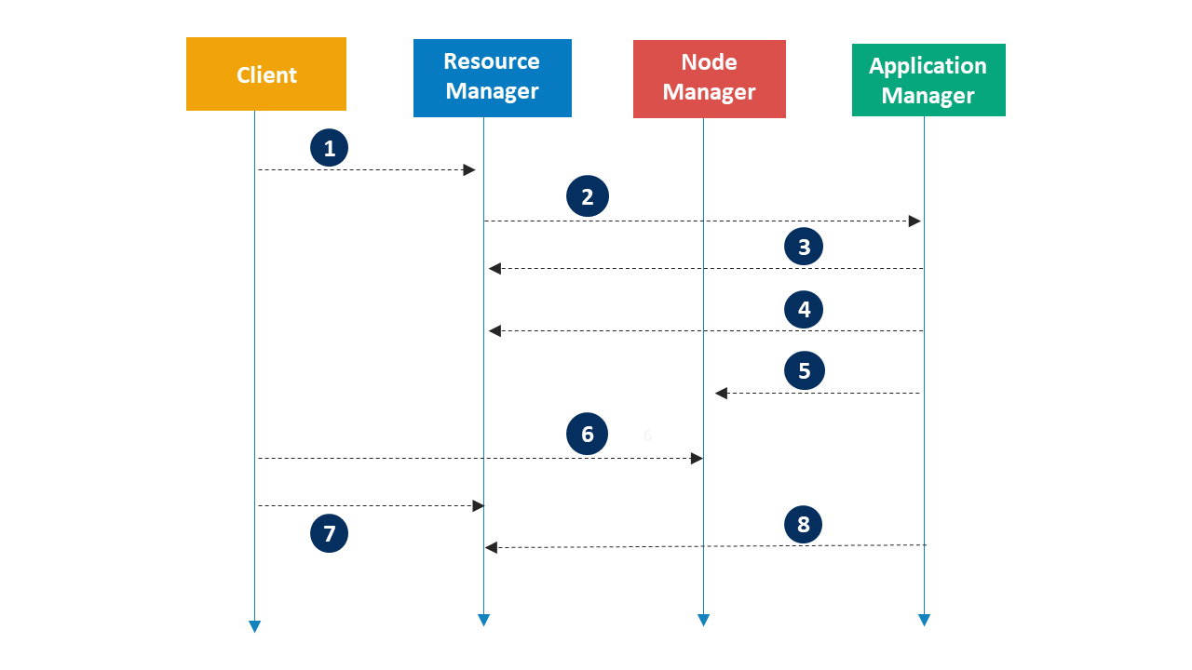

Slide 21
CON…
Suppose a client machine wants to do a query or fetch some code for data analysis. This job request goes to the resource manager (Hadoop Yarn), which is responsible for resource allocation and management.
In the node section, each of the nodes has its node managers. These node managers manage the nodes and monitor the resource usage in the node. The containers contain a collection of physical resources, which could be RAM, CPU, or hard drives. Whenever a job request comes in, the app master requests the container from the node manager. Once the node manager gets the resource, it goes back to the Resource Manager.

Slide 22
Introduction to Hadoop Tools
Hadoop is an open-source framework written in Java that uses lots of other analytical tools to improve its data analytics operations.
There is a wide range of analytical tools available in the market that help Hadoop deal with the astronomical size data efficiently.
The most famous and widely used tools :
Sqoop
Flume
APACHE Pig
Oozie
HBase

Slide 23


Slide 24
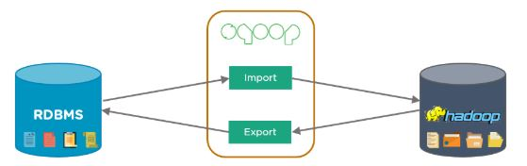
Sqoop
Sqoop is used to transfer data between Hadoop and external datastores such as relational databases and enterprise data warehouses. It imports data from external datastores into HDFS, Hive, and HBase.
The client machine gathers code, which will then be sent to Sqoop. The Sqoop then goes to the Task Manager, which in turn connects to the enterprise data warehouse, documents based systems, and RDBMS. It can map those tasks into Hadoop

Slide 25
To process data using Hadoop, the data first needs to be loaded into Hadoop clusters from several sources. However, it turned out that the process of loading data from several heterogeneous sources was extremely challenging. The problems administrators encountered included:
Maintaining data consistency
Ensuring efficient utilization of resources
Loading bulk data to Hadoop was not possible
Loading data using scripts was slow

Slide 26
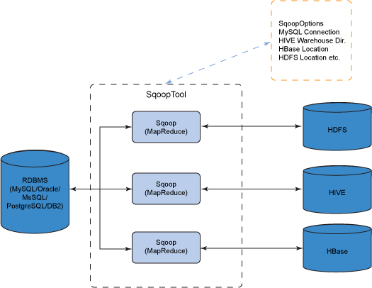

Slide 27
Sqoop Working
Step 1: Sqoop send the request to Relational DB to send the return the metadata information about the table(Metadata here is the data about the table in relational DB).
Step 2: From the received information it will generate the java classes (Reason why you should have Java configured before get it working-Sqoop internally uses JDBC API to generate data).
Step 3: Now Sqoop (As its written in java ?tries to package the compiled classes to be able to generate table structure) , post compiling creates jar file(Java packaging standard).

Slide 28
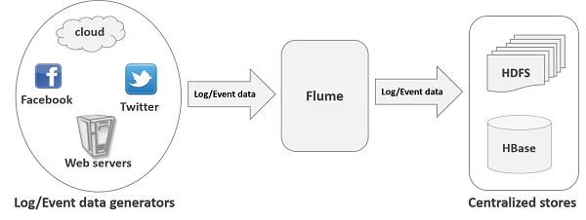
Flume
Flume is another data collection and ingestion tool, a distributed service for collecting, aggregating, and moving large amounts of log data. It ingests online streaming data from social media, logs files, web server into HDFS.

Slide 29
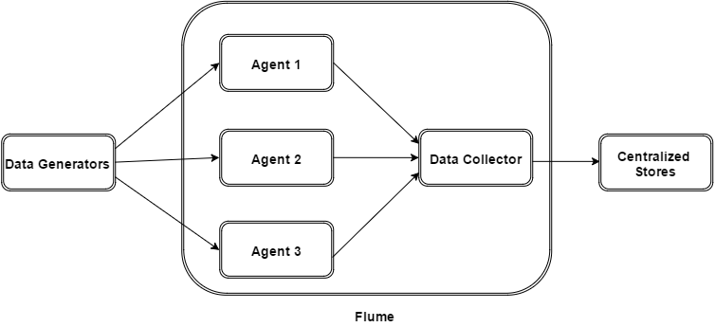

Slide 30
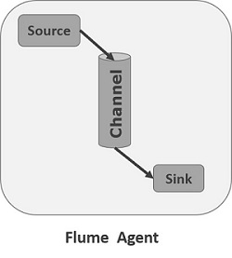


Slide 31
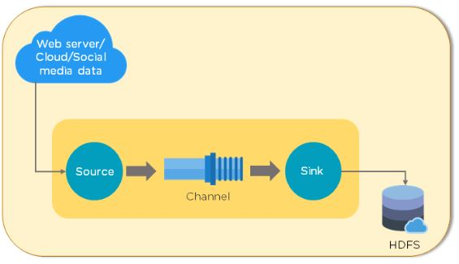
CON…
data is taken from various sources, depending on your organization’s needs. It then goes through the source, channel, and sink. The sink feature ensures that everything is in sync with the requirements. Finally, the data is dumped into HDFS.

Slide 32
Pig
Apache Pig was developed by Yahoo researchers, targeted mainly towards non-programmers. It was designed with the ability to analyze and process large datasets without using complex Java codes. It provides a high-level data processing language that can perform numerous operations without getting bogged down with too many technical concepts.
It consists of:
Pig Latin - This is the language for scripting
Pig Latin Compiler - This converts Pig Latin code into executable code
Pig also provides Extract, Transfer, and Load (ETL), and a platform for building data flow. Did you know that ten lines of Pig Latin script equals approximately 200 lines of MapReduce job? Pig uses simple, time-efficient steps to analyze datasets

Slide 33
Features of Pig
Rich set of operators
Ease of programming
Extensibility
UDF’s
Handles all kinds of data

Slide 34
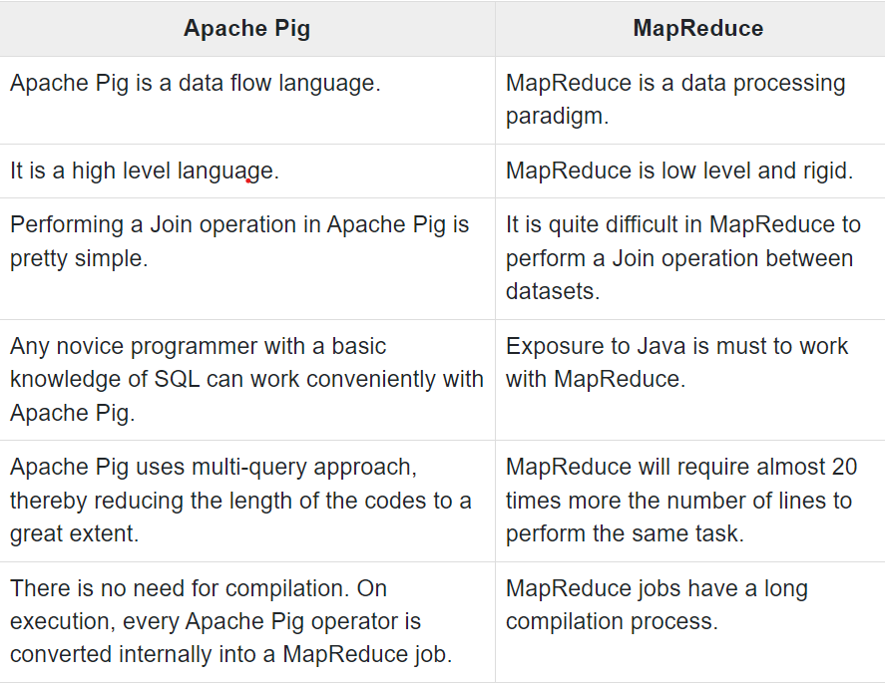

Slide 35
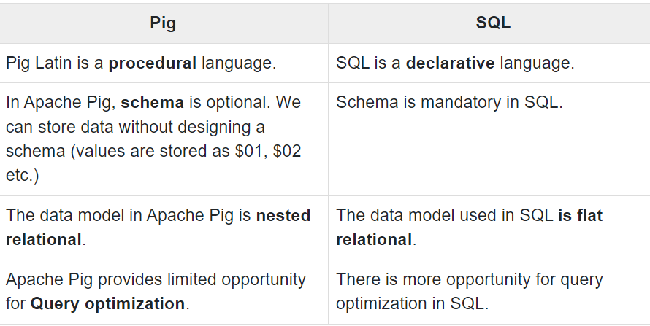

Slide 36
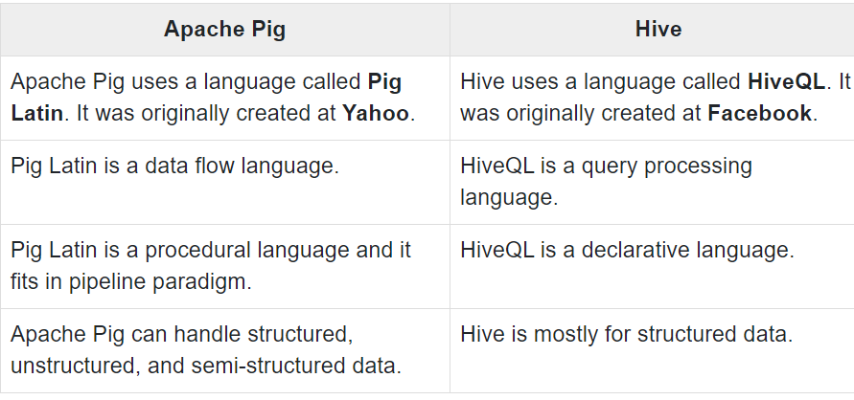

Slide 37
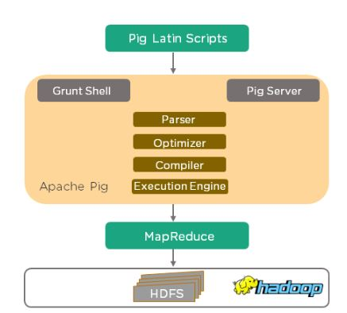
Pig’s architecture

Slide 38
CON…
Programmers write scripts in Pig Latin to analyze data using Pig. Grunt Shell is Pig’s interactive shell, used to execute all Pig scripts.
If the Pig script is written in a script file, the Pig Server executes it.
The parser checks the syntax of the Pig script, after which the output will be a DAG (Directed Acyclic Graph). The DAG (logical plan) is passed to the logical optimizer.
The compiler converts the DAG into MapReduce jobs.
The MapReduce jobs are then run by the Execution Engine. The results are displayed using the “DUMP” statement and stored in HDFS using the “STORE” statement.

Slide 39
Oozie
Oozie is a workflow scheduler system used to manage Hadoop jobs. It consists of two parts:
Workflow engine - This consists of Directed Acyclic Graphs (DAGs), which specify a sequence of actions to be executed
Coordinator engine - The engine is made up of workflow jobs triggered by time and data availability
As seen from the flowchart below, the process begins with the MapReduce jobs. This action can either be successful, or it can end in an error. If it is successful, the client is notified by an email. If the action is unsuccessful, the client is similarly notified, and the action is terminated.

Slide 40
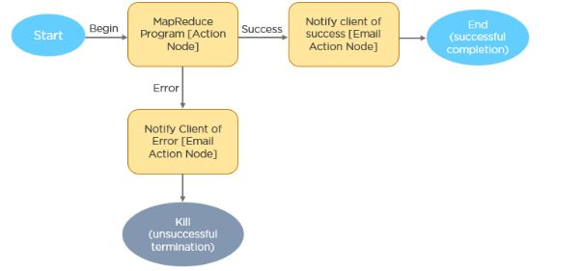
Oozie CON…..

Slide 41
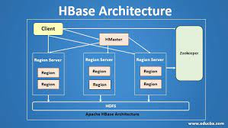
HBase
HBase is nothing but a non-relational, NoSQL distributed, and column-oriented database. HBase consists of various tables where each table has multiple numbers of data rows. These rows will have multiple numbers of column family’s, and this column family will have columns that contain key-value pairs. HBase works on the top of HDFS(Hadoop Distributed File System). We use HBase for searching small size data from the more massive datasets.
Features of HBase:
HBase has Linear and Modular Scalability
JAVA API can easily be used for client access
Block cache for real time data queries

Slide 42
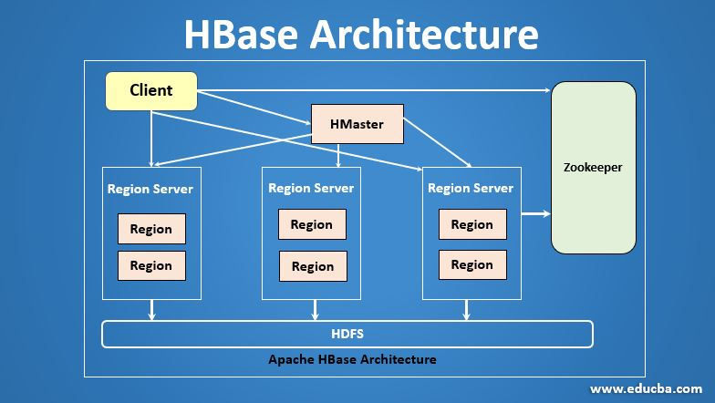

Slide 43
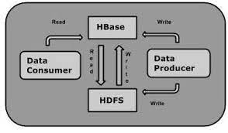

Slide 44
Hadoop Distributed File System (HDFS)
The Hadoop Distributed File System (HDFS) is the primary data storage system used by Hadoop applications. HDFS employs a NameNode and DataNode architecture to implement a distributed file system that provides high-performance access to data across highly scalable Hadoop clusters.
Hadoop itself is an open source distributed processing framework that manages data processing and storage for big data applications.
HDFS is a key part of the many Hadoop ecosystem technologies.
It provides a reliable means for managing pools of big data and supporting related big data analytics applications

Slide 45
How Does HDFS work?
HDFS enables the rapid transfer of data between compute nodes.
At its outset, it was closely coupled with MapReduce, a framework for data processing that filters and divides up work among the nodes in a cluster, and it organizes and condenses the results into a cohesive answer to a query.
Similarly, when HDFS takes in data, it breaks the information down into separate blocks and distributes them to different nodes in a cluster.
With HDFS, data is written on the server once, and read and reused numerous times after that. HDFS has a primary NameNode, which keeps track of where file data is kept in the cluster.
HDFS also has multiple DataNodes on a commodity hardware cluster -- typically one per node in a cluster.
The DataNodes are generally organized within the same rack in the data center. Data is broken down into separate blocks and distributed among the various DataNodes for storage.
Blocks are also replicated across nodes, enabling highly efficient parallel processing.

Slide 46
The NameNode knows which DataNode contains which blocks and where the DataNodes reside within the machine cluster. The NameNode also manages access to the files, including reads, writes, creates, deletes and the data block replication across the DataNodes.
The NameNode operates in conjunction with the DataNodes. As a result, the cluster can dynamically adapt to server capacity demand in real time by adding or subtracting nodes as necessary.
The DataNodes are in constant communication with the NameNode to determine if the DataNodes need to complete specific tasks. Consequently, the NameNode is always aware of the status of each DataNode.

Slide 47
If the NameNode realizes that one DataNode isn't working properly, it can immediately reassign that DataNode's task to a different node containing the same data block.
DataNodes also communicate with each other, which enables them to cooperate during normal file operations.
Moreover, the HDFS is designed to be highly fault-tolerant.
The file system replicates -- or copies -- each piece of data multiple times and distributes the copies to individual nodes, placing at least one copy on a different server rack than the other copies.

Slide 48
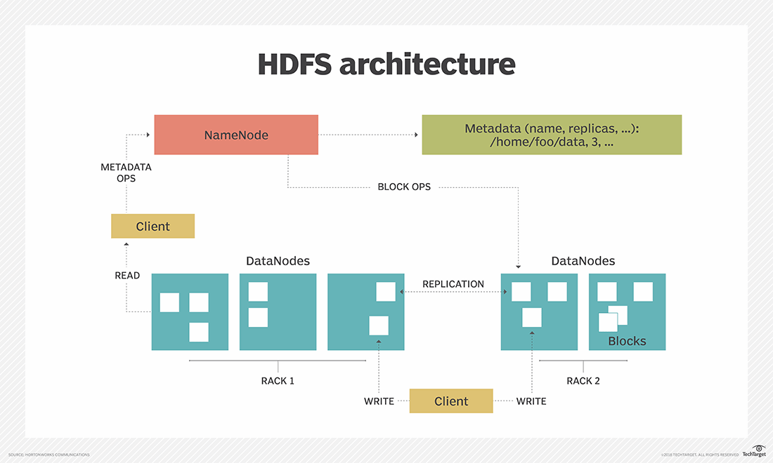

Slide 49
HDFS architecture, NameNodes and DataNodes
HDFS uses a primary/secondary architecture.
The HDFS cluster's NameNode is the primary server that manages the file system namespace and controls client access to files.
As the central component of the Hadoop Distributed File System, the NameNode maintains and manages the file system namespace and provides clients with the right access permissions.
The system's DataNodes manage the storage that's attached to the nodes they run on.
HDFS exposes a file system namespace and enables user data to be stored in files. A file is split into one or more of the blocks that are stored in a set of DataNodes.
The NameNode performs file system namespace operations, including opening, closing and renaming files and directories.
The NameNode also governs the mapping of blocks to the DataNodes. The DataNodes serve read and write requests from the clients of the file system.
In addition, they perform block creation, deletion and replication when the NameNode instructs them to do so.

Slide 50
HDFS supports a traditional hierarchical file organization.
An application or user can create directories and then store files inside these directories.
The file system namespace hierarchy is like most other file systems
-- a user can create, remove, rename or move files from one directory to another.
The NameNode records any change to the file system namespace or its properties.
An application can stipulate the number of replicas of a file that the HDFS should maintain.
The NameNode stores the number of copies of a file, called the replication factor of that file.

Slide 51
Features of HDFS
There are several features that make HDFS particularly useful, including:
Data replication. This is used to ensure that the data is always available and prevents data loss. For example, when a node crashes or there is a hardware failure, replicated data can be pulled from elsewhere within a cluster, so processing continues while data is recovered.
Fault tolerance and reliability: HDFS' ability to replicate file blocks and store them across nodes in a large cluster ensures fault tolerance and reliability.
High availability: As mentioned earlier, because of replication across notes, data is available even if the NameNode or a DataNode fails.
Scalability: Because HDFS stores data on various nodes in the cluster, as requirements increase, a cluster can scale to hundreds of nodes.

Slide 52
High throughput: Because HDFS stores data in a distributed manner, the data can be processed in parallel on a cluster of nodes. This, plus data locality (see next bullet), cut the processing time and enable high throughput.
Data locality: With HDFS, computation happens on the DataNodes where the data resides, rather than having the data move to where the computational unit is. By minimizing the distance between the data and the computing process, this approach decreases network congestion and boosts a system's overall throughput.

Slide 53
What are the benefits of using HDFS?
There are five main advantages to using HDFS, including:
Cost effectiveness: The DataNodes that store the data rely on inexpensive off-the-shelf hardware, which cuts storage costs. Also, because HDFS is open source, there's no licensing fee.
Large data set storage: HDFS stores a variety of data of any size -- from megabytes to petabytes -- and in any format, including structured and unstructured data.
Fast recovery from hardware failure: HDFS is designed to detect faults and automatically recover on its own.
Portability: HDFS is portable across all hardware platforms, and it is compatible with several operating systems, including Windows, Linux and Mac OS/X.
Streaming data access: HDFS is built for high data throughput, which is best for access to streaming data.

Slide 54
HDFS Data Replication
Data replication is an important part of the HDFS format as it ensures data remains available if there's a node or hardware failure.
As previously mentioned, the data is divided into blocks and replicated across numerous nodes in the cluster.
Therefore, when one node goes down, the user can access the data that was on that node from other machines.
HDFS maintains the replication process at regular intervals.

Slide 55
HDFS use cases and examples
The Hadoop Distributed File System emerged at Yahoo as a part of that company's online ad placement and search engine requirements.
Like other web-based companies, Yahoo juggled a variety of applications that were accessed by an increasing number of users, who were creating more and more data.
EBay, Facebook, LinkedIn and Twitter are among the companies that used HDFS to underpin big data analytics to address requirements similar to Yahoo's.
HDFS has found use beyond meeting ad serving and search engine requirements.
The New York Times used it as part of large-scale image conversions, Media6Degrees for log processing and machine learning, LiveBet for log storage and odds analysis, Joost for session analysis, and Fox Audience Network for log analysis and data mining. HDFS is also at the core of many open source data lakes.

Slide 56
More generally, companies in several industries use HDFS to manage pools of big data, including:
Electric companies: The power industry deploys phasor measurement units (PMUs) throughout their transmission networks to monitor the health of smart grids.
These high-speed sensors measure current and voltage by amplitude and phase at selected transmission stations.
These companies analyze PMU data to detect system faults in network segments and adjust the grid accordingly.
For instance, they might switch to a backup power source or perform a load adjustment. PMU networks clock thousands of records per second, and consequently, power companies can benefit from inexpensive, highly available file systems, such as HDFS.
Marketing: Targeted marketing campaigns depend on marketers knowing a lot about their target audiences.
Marketers can get this information from several sources, including CRM systems, direct mail responses, point-of-sale systems, Facebook and Twitter.
Because much of this data is unstructured, an HDFS cluster is the most cost-effective place to put data before analyzing it.

Slide 57
Oil and gas providers: Oil and gas companies deal with a variety of data formats with very large data sets, including videos, 3D earth models and machine sensor data. An HDFS cluster can provide a suitable platform for the big data analytics that's needed.
Research: Analyzing data is a key part of research, so, here again, HDFS clusters provide a cost-effective way to store, process and analyze large amounts of data.

Slide 58
HDFS Commands with Examples and Usage
HDFS is the primary or major component of the Hadoop ecosystem which is responsible for storing large data sets of structured or unstructured data across various nodes and thereby maintaining the metadata in the form of log files.

Slide 59
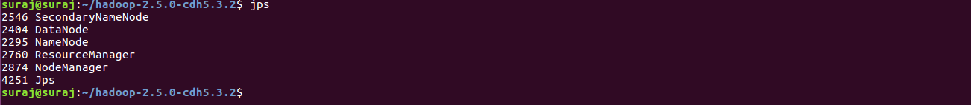
To check the Hadoop services are up and running use the following command:
jps

Slide 60
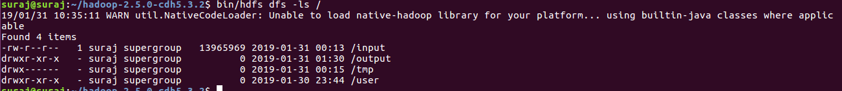
ls: This command is used to list all the files. Use lsr for recursive approach. It is useful when we want a hierarchy of a folder.
Syntax:
bin/hdfs dfs -ls <path>
Example:
bin/hdfs dfs -ls /
It will print all the directories present in HDFS. bin directory contains executables so, bin/hdfs means we want the executables
of hdfs particularly dfs(Distributed File System) commands.

Slide 61
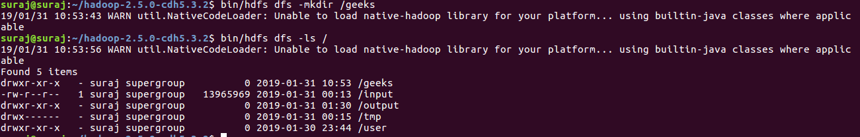
mkdir: To create a directory. In Hadoop dfs there is no home directory by default. So let’s first create it.
Syntax:
bin/hdfs dfs -mkdir <folder name> creating home directory: hdfs/bin -mkdir /user hdfs/bin -mkdir /user/username -> write the username of your computer
Example:
bin/hdfs dfs -mkdir /geeks => '/' means absolute path bin/hdfs dfs -mkdir geeks2 => Relative path -> the folder will be created relative to the home directory.

Slide 62
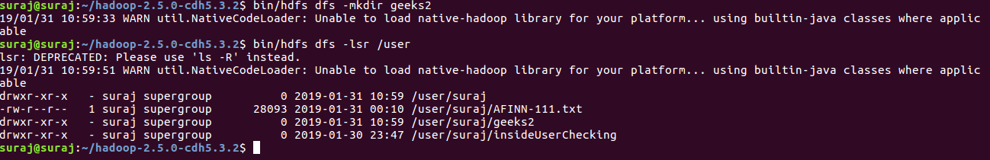

Slide 63
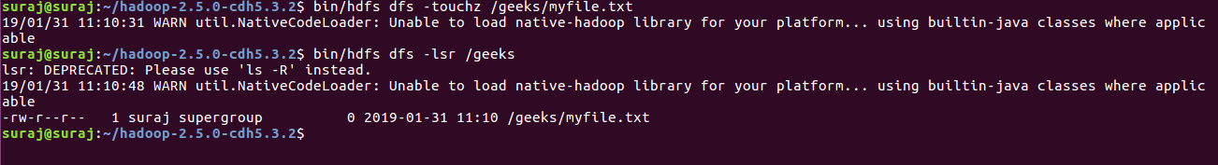
touchz: It creates an empty file.
Syntax:
bin/hdfs dfs -touchz <file_path>
Example: hdfs dfs –touch /geeks/myfile.txt
bin/hdfs dfs -touchz /geeks/myfile.txt

Slide 64
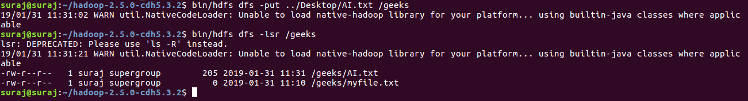
copyFromLocal (or) put: To copy files/folders from local file system to hdfs store. This is the most important command. Local filesystem means the files present on the OS.
Syntax:
bin/hdfs dfs -copyFromLocal <local file path> <dest(present on hdfs)>
Example: Let’s suppose we have a file AI.txt on Desktop which we want to copy to folder geeks present on hdfs.
bin/hdfs dfs -copyFromLocal ../Desktop/AI.txt /geeks (OR) bin/hdfs dfs -put ../Desktop/AI.txt /geeks

Slide 65
5 cat: To print file contents.
Syntax:
bin/hdfs dfs -cat <path>
Example:
// print the content of AI.txt present // inside geeks folder. bin/hdfs dfs -cat /geeks/AI.txt ->

Slide 66
copyToLocal (or) get: To copy files/folders from hdfs store to local file system.
Syntax:
bin/hdfs dfs -copyToLocal <<srcfile(on hdfs)> <local file dest>
Example:
bin/hdfs dfs -copyToLocal /geeks ../Desktop/hero (OR) bin/hdfs dfs -get /geeks/myfile.txt ../Desktop/hero
myfile.txt from geeks folder will be copied to folder hero present on Desktop.

Slide 67
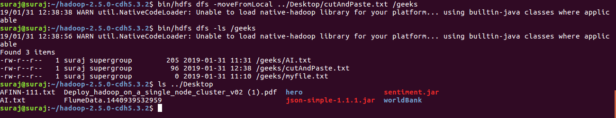
moveFromLocal: This command will move file from local to hdfs.
Syntax:
bin/hdfs dfs -moveFromLocal <local src> <dest(on hdfs)>
Example:
bin/hdfs dfs -moveFromLocal ../Desktop/cutAndPaste.txt /geeks

Slide 68
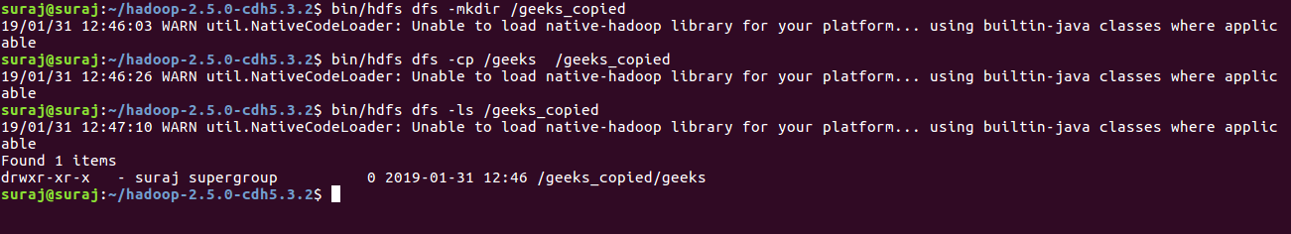
cp: This command is used to copy files within hdfs. Lets copy folder geeks to geeks_copied.
Syntax:
bin/hdfs dfs -cp <src(on hdfs)> <dest(on hdfs)>
Example:
bin/hdfs -cp /geeks /geeks_copied

Slide 69
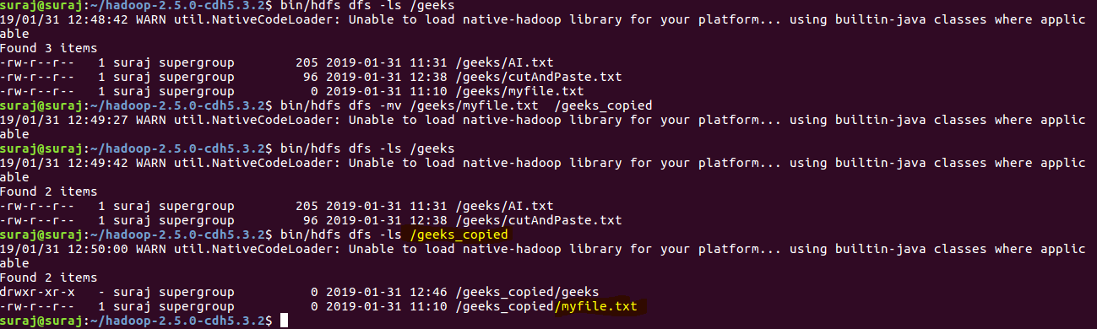
mv: This command is used to move files within hdfs. Lets cut-paste a file myfile.txt from geeks folder to geeks_copied.
Syntax:
bin/hdfs dfs -mv <src(on hdfs)> <src(on hdfs)>
Example:
bin/hdfs -mv /geeks/myfile.txt /geeks_copied

Slide 70
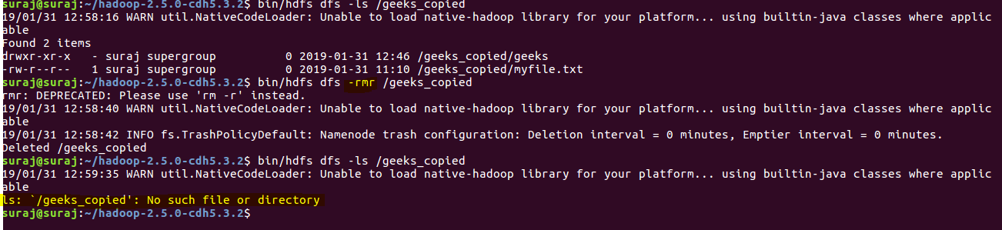
rmr: This command deletes a file from HDFS recursively. It is very useful command when you want to delete a non-empty directory.
Syntax:
bin/hdfs dfs -rmr <filename/directoryName>
Example:
bin/hdfs dfs -rmr /geeks_copied -> It will delete all the content inside the directory then the directory itself.

